Slide 1
Data Analysis with Python Pandas and Numpy
Žydrūnė Kelpšaitė, Data Analyst

Slide 2
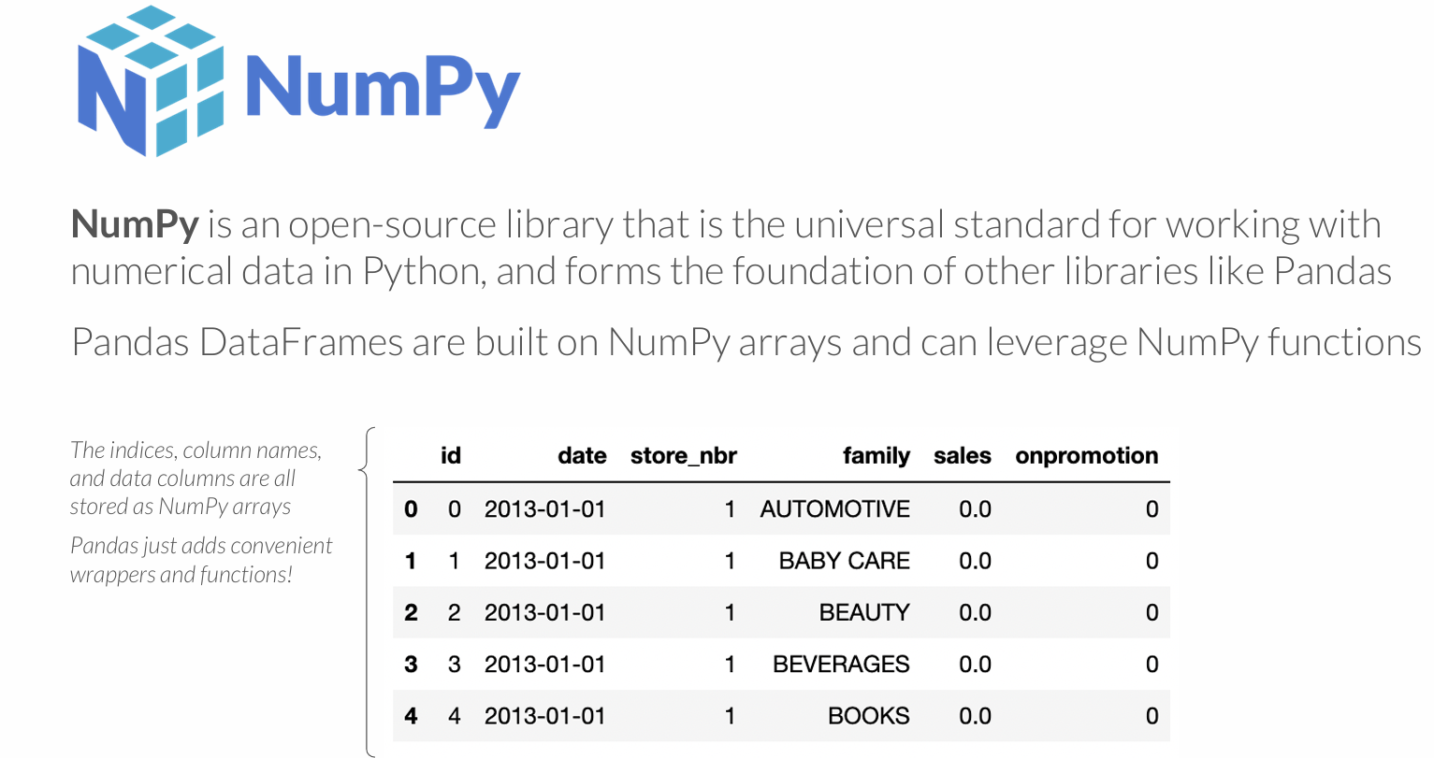

Slide 3
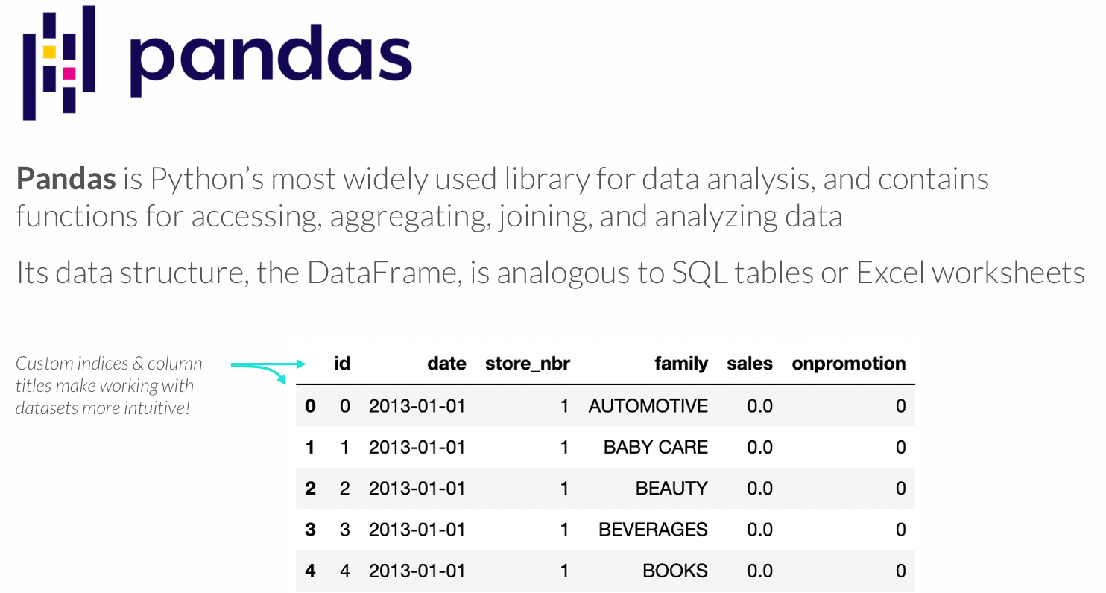
MEET PANDAS

Slide 4
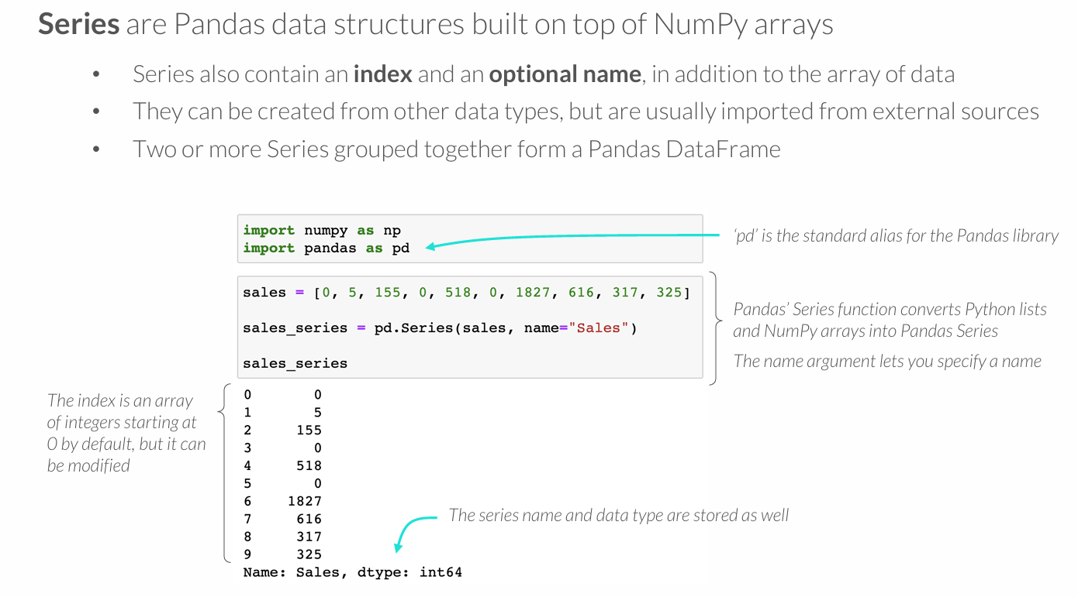
PANDAS SERIES

Slide 5
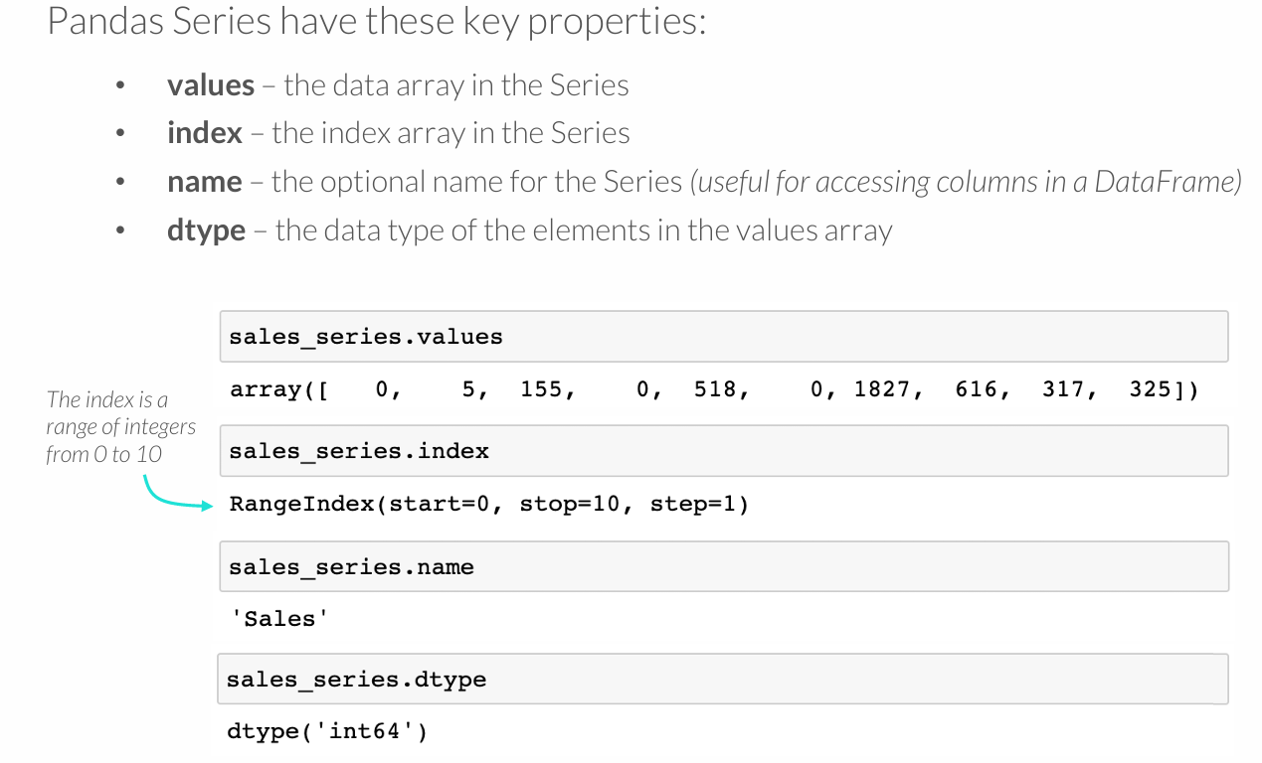
SERIES PROPERTIES

Slide 6
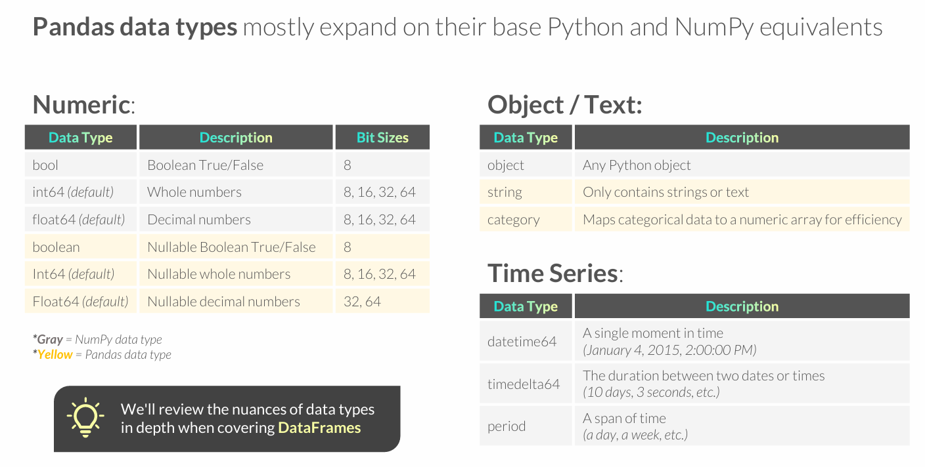
PANDAS DATA TYPES

Slide 7
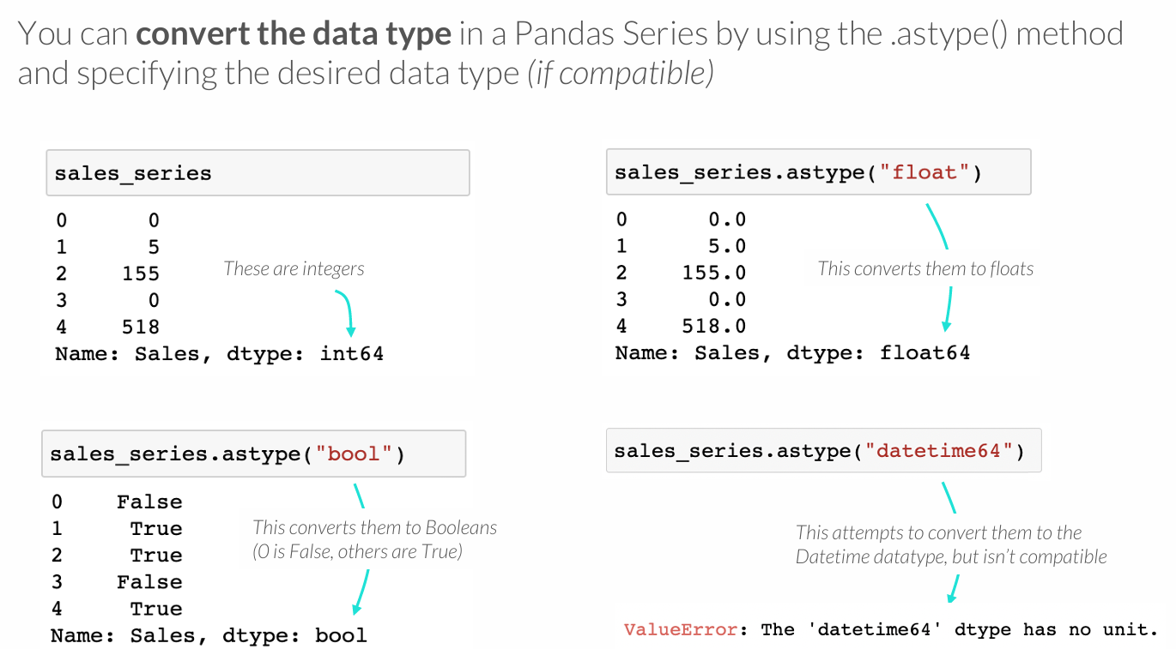
TYPE CONVERSION
Notes:
SVARBU

Slide 8
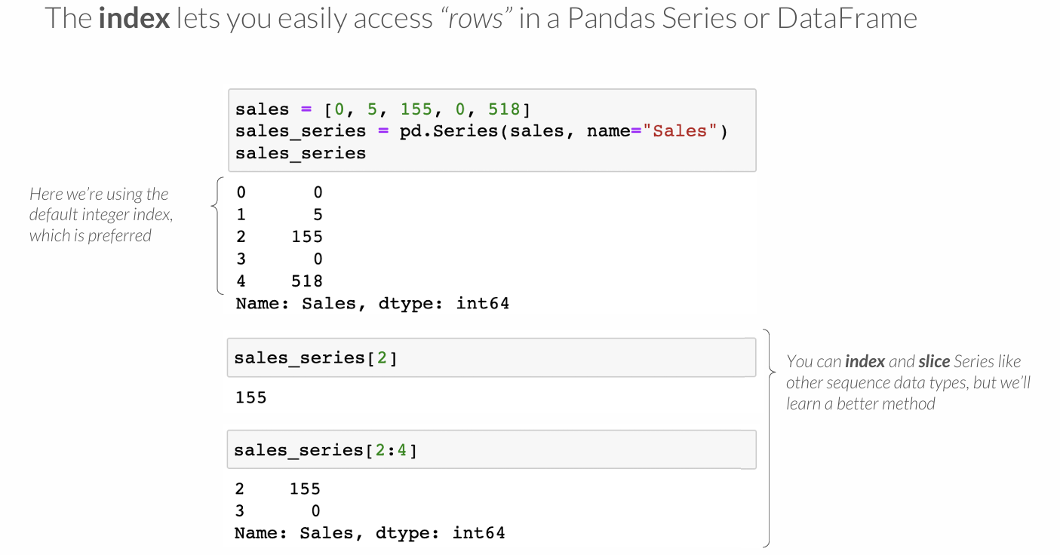
THE INDEX

Slide 9
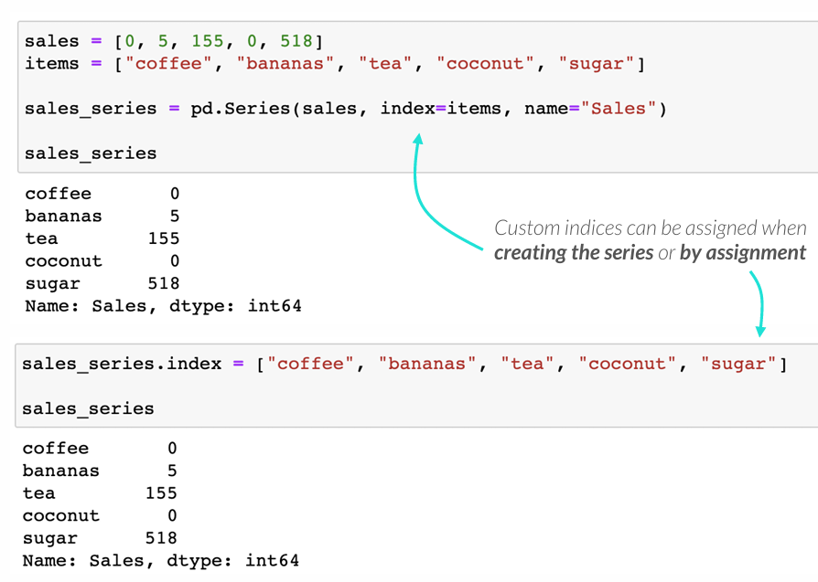
CUSTOM INDICES
There are cases where it’s applicable to use a custom index for accessing rows

Slide 10
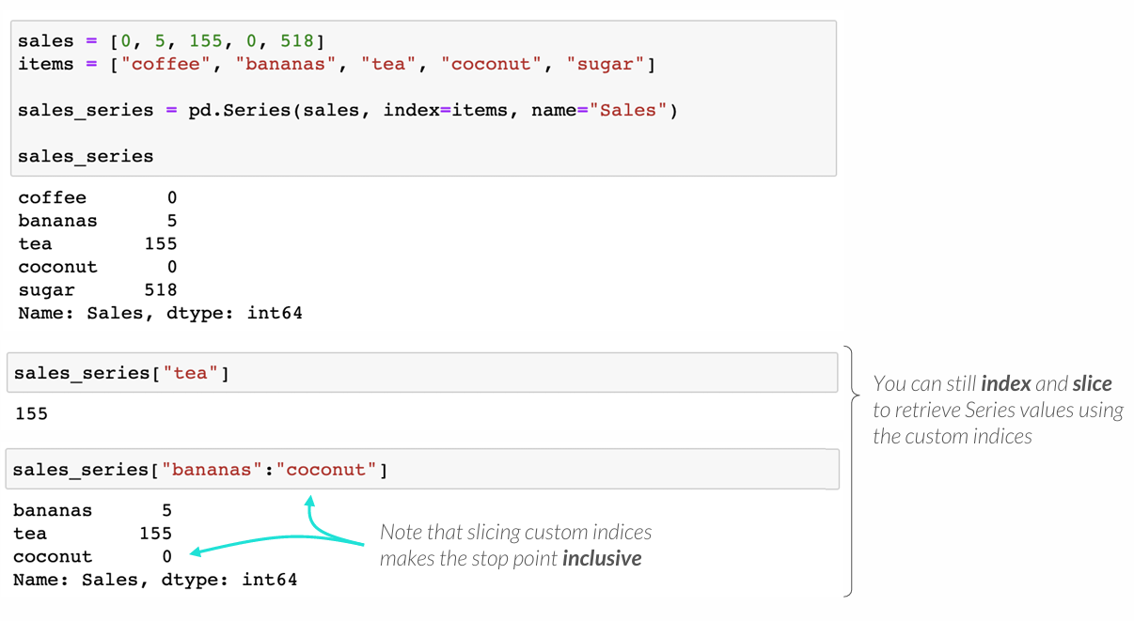
CUSTOM INDICES
There are cases where it’s applicable to use a custom index for accessing rows

Slide 11
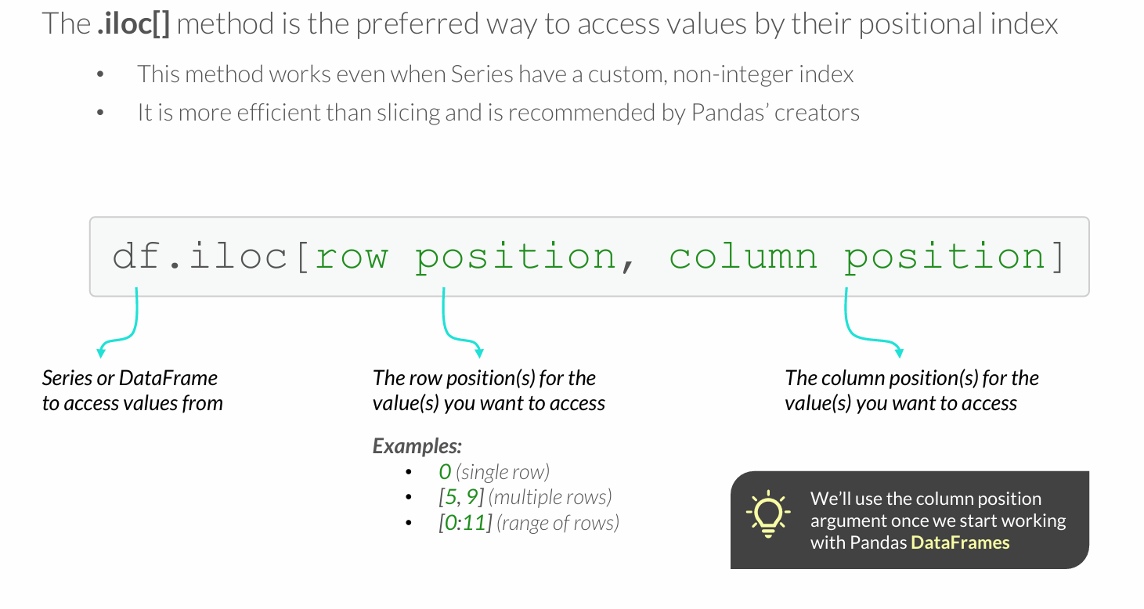
THE ILOC METHOD

Slide 12
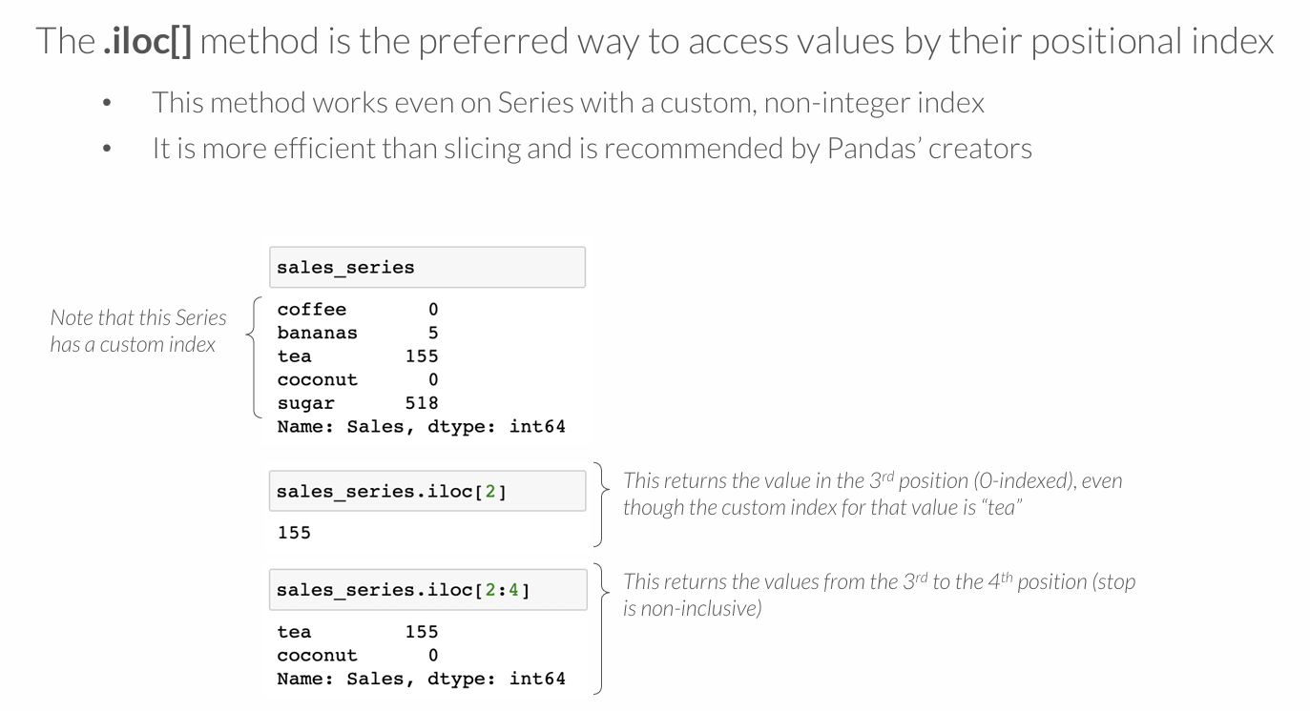
THE ILOC METHOD

Slide 13
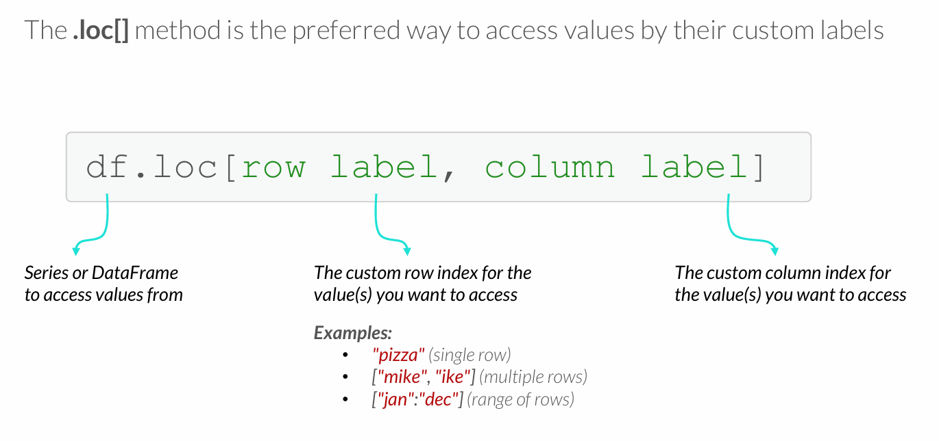
THE LOC METHOD

Slide 14
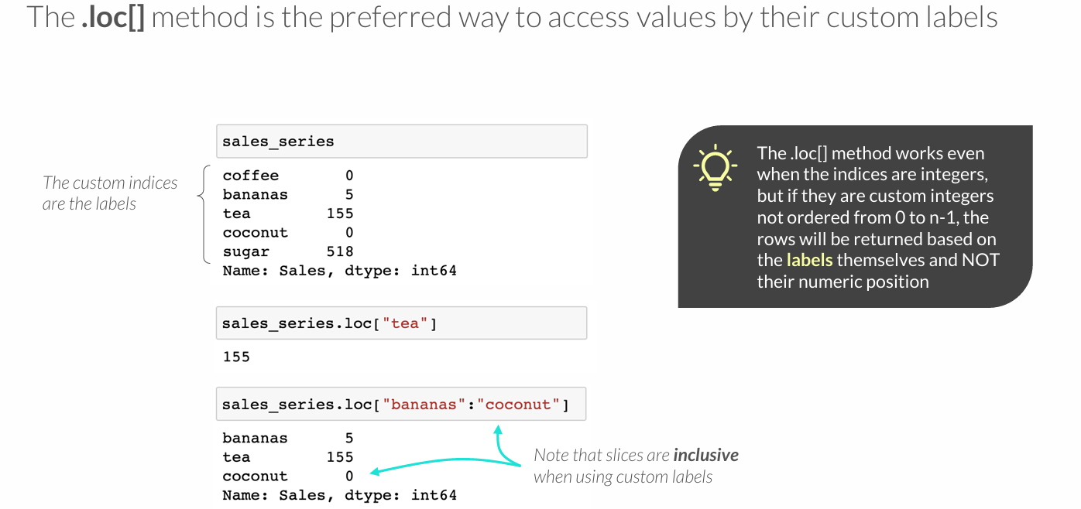
THE LOC METHOD

Slide 15
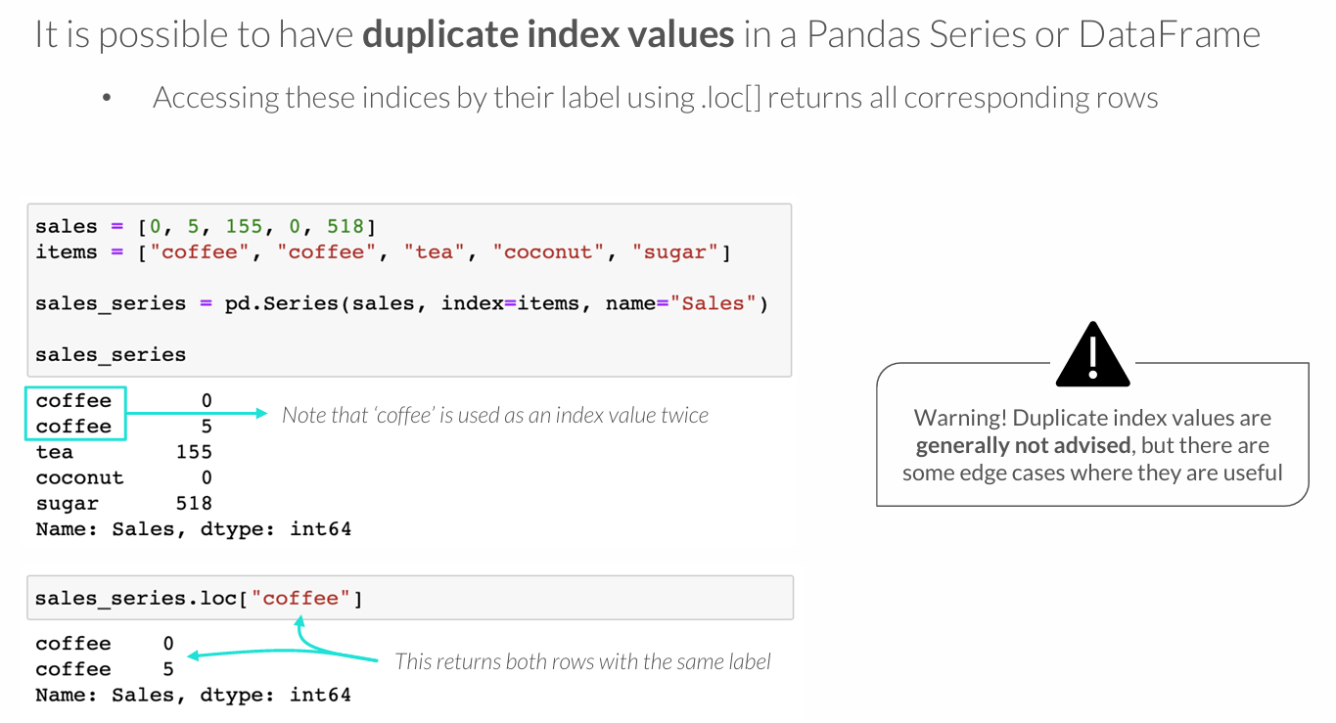
DUPLICATE INDEX VALUES

Slide 16
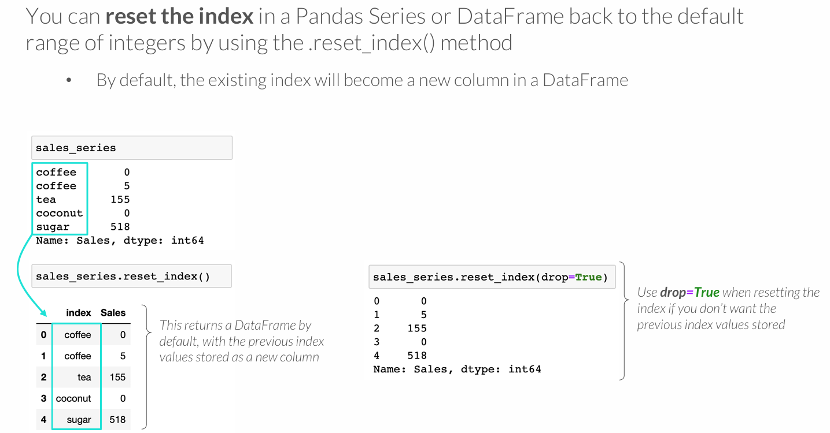
RESETTING THE INDEX

Slide 17
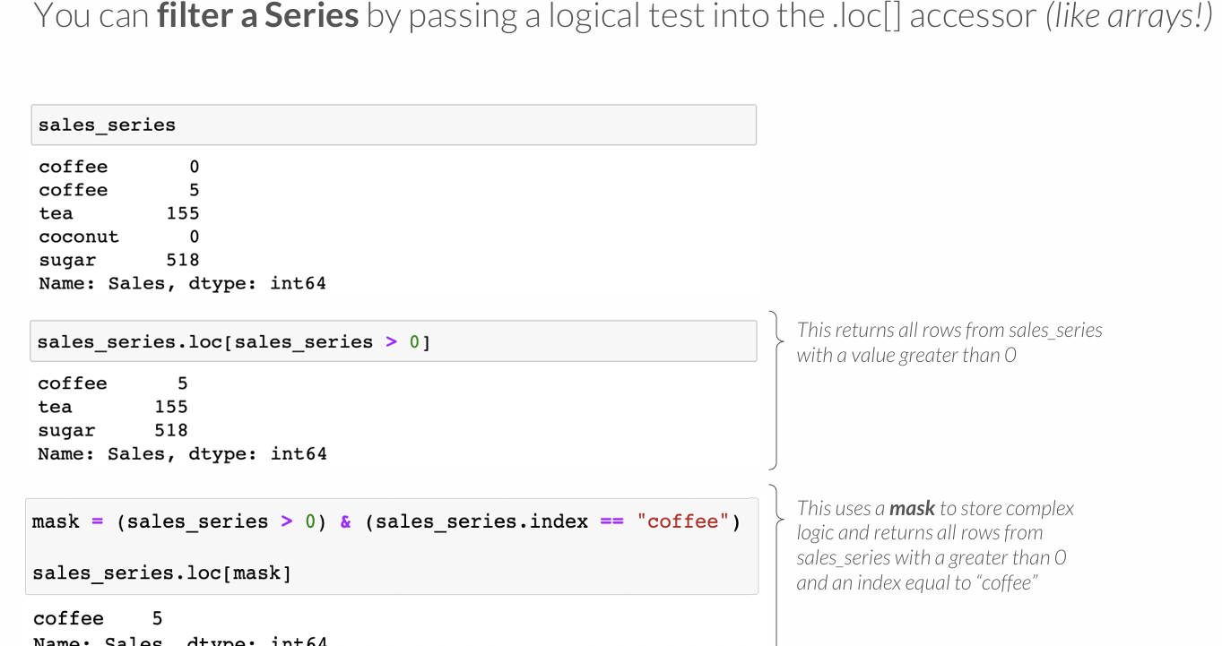
FILTERING SERIES

Slide 18
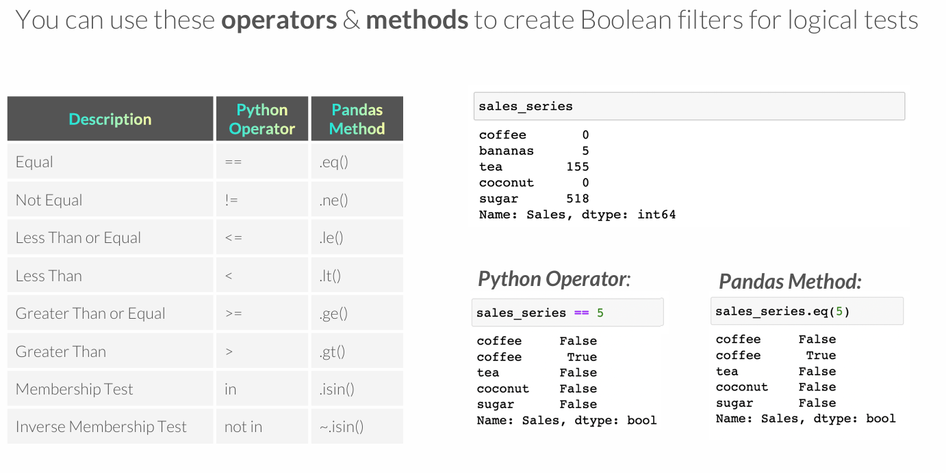
LOGICAL OPERATORS & METHODS

Slide 19
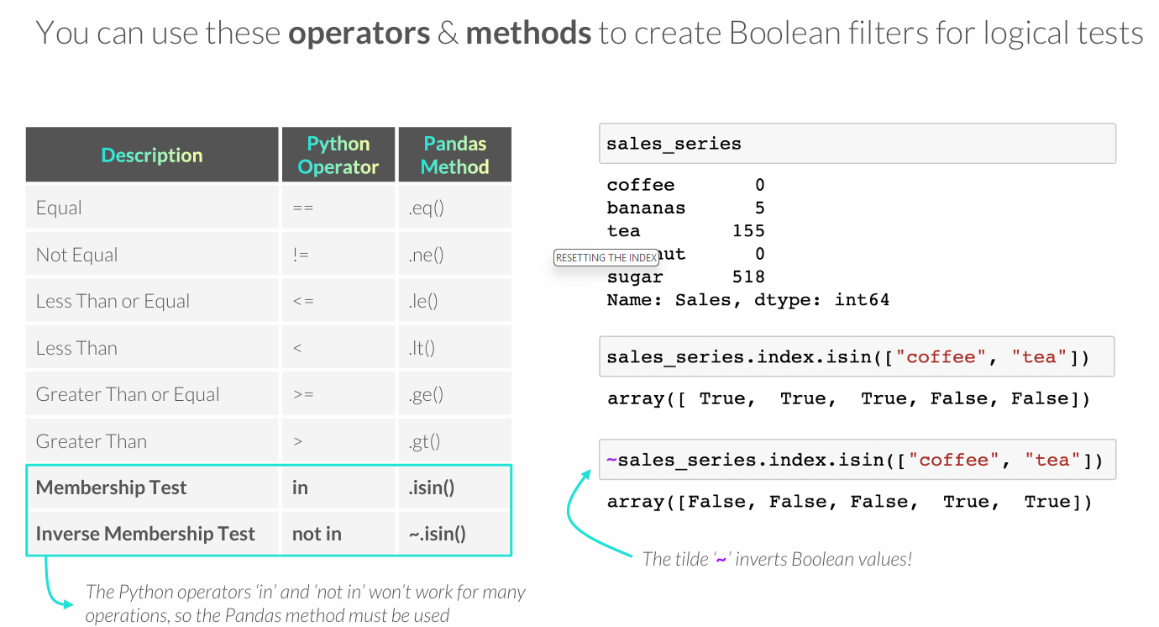
LOGICAL OPERATORS & METHODS

Slide 20
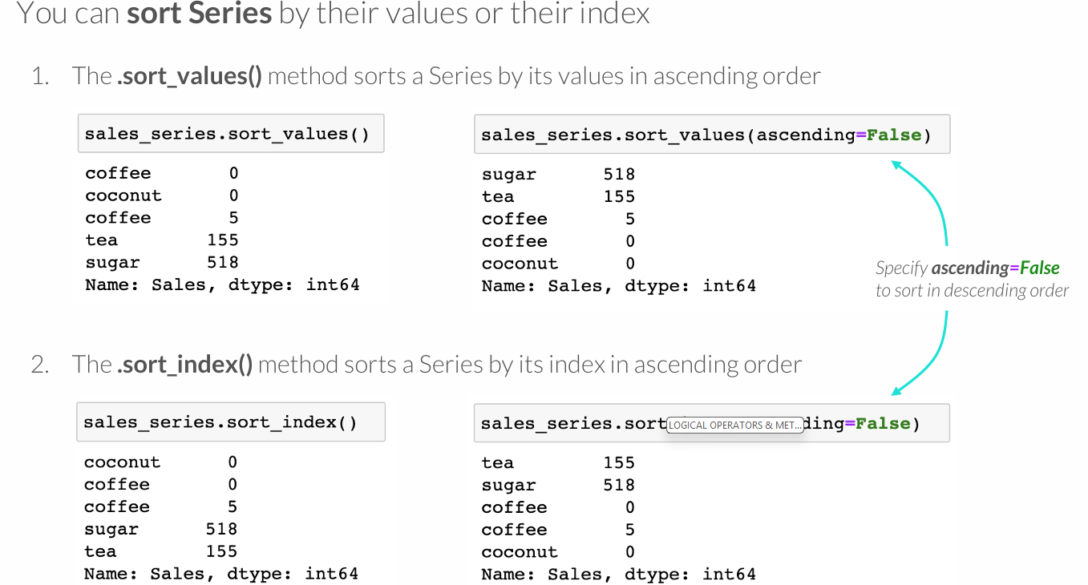
SORTING SERIES
Notes:
SVARBU

Slide 21
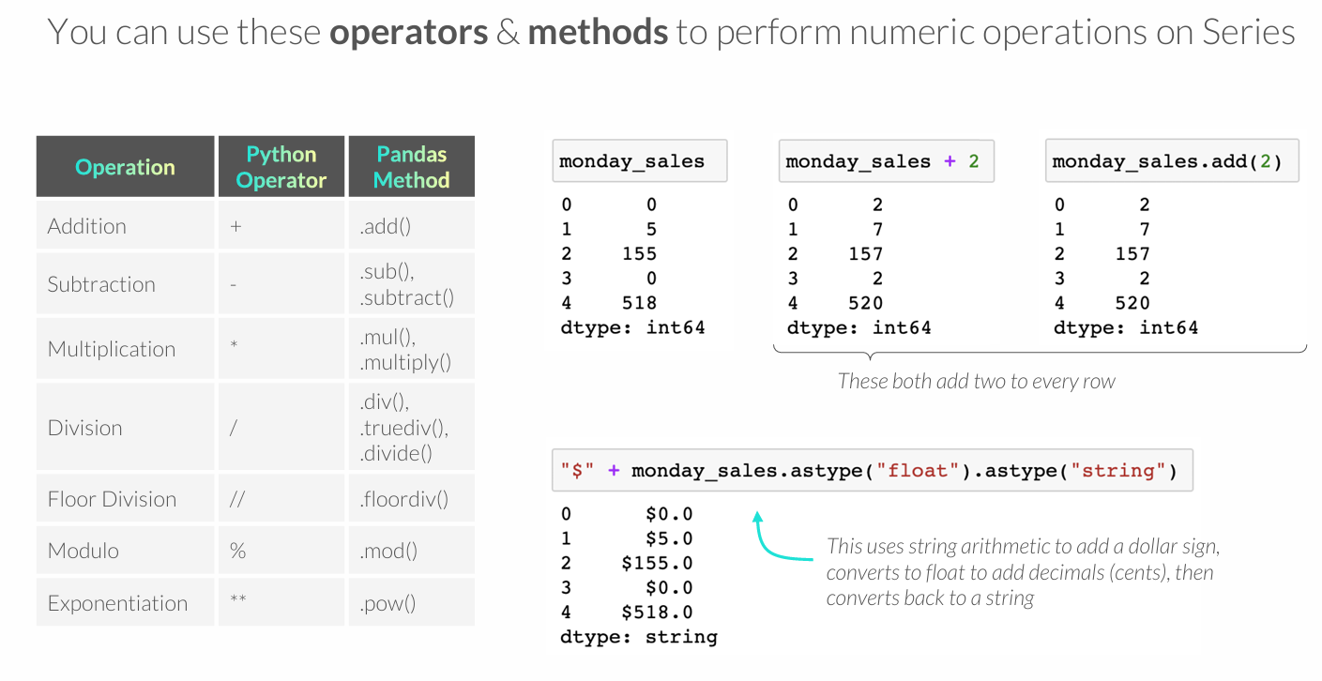
ARITHMETIC OPERATORS & METHODS

Slide 22
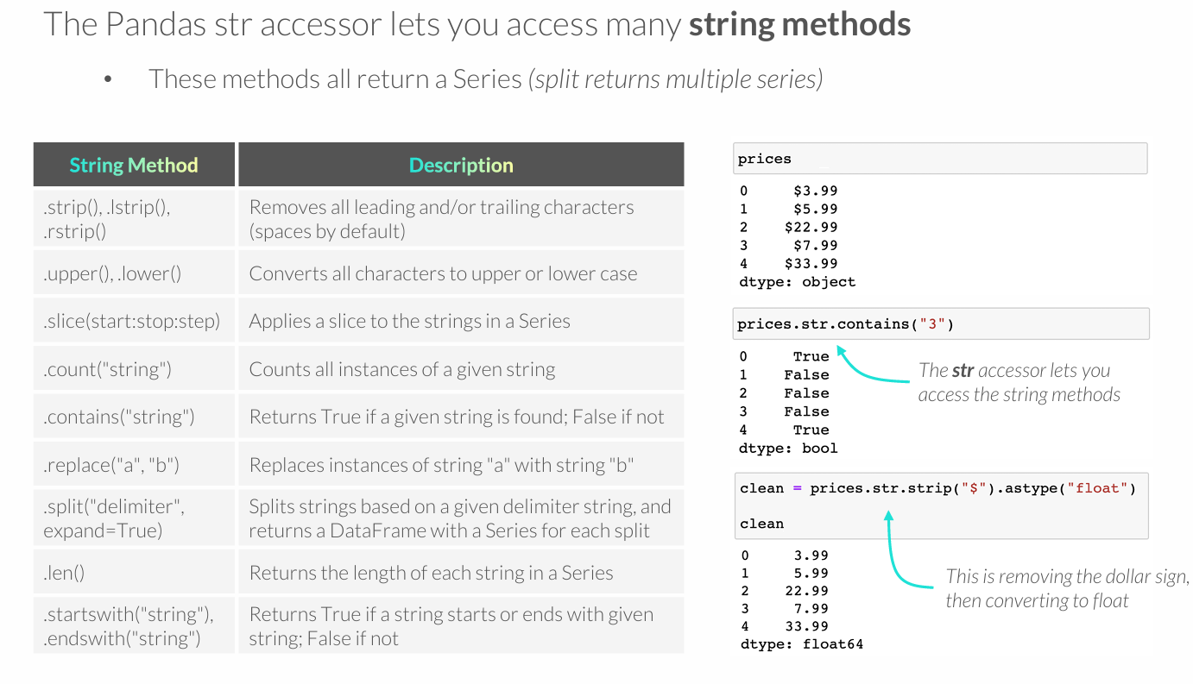
STRING METHODS
Notes:
DARBINIAI

Slide 23
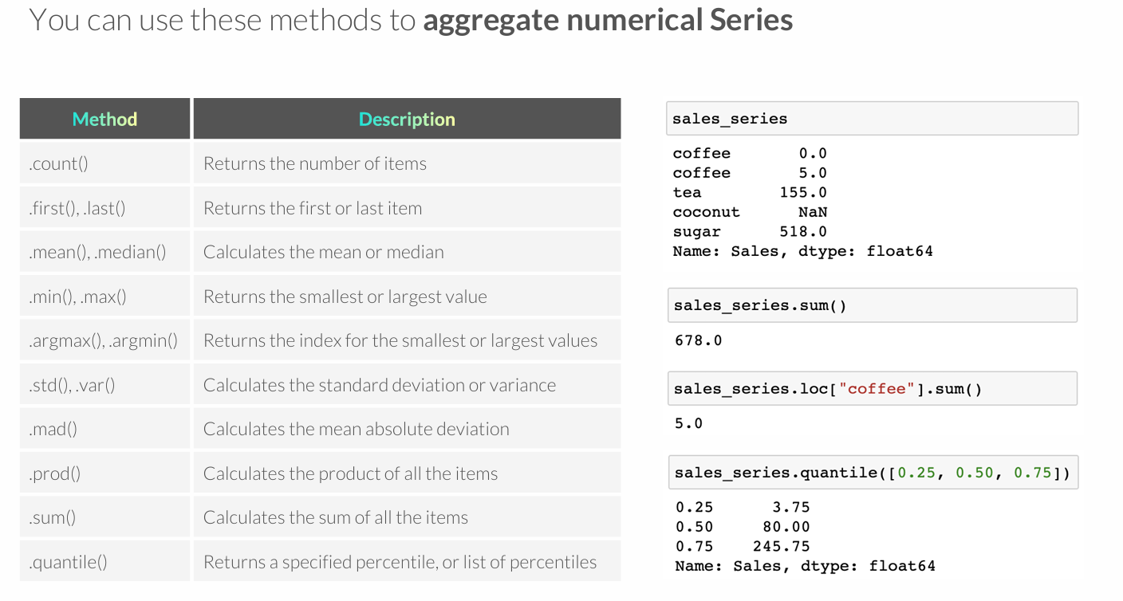
NUMERIC SERIES AGGREGATION
Notes:
DARBINĖS

Slide 24
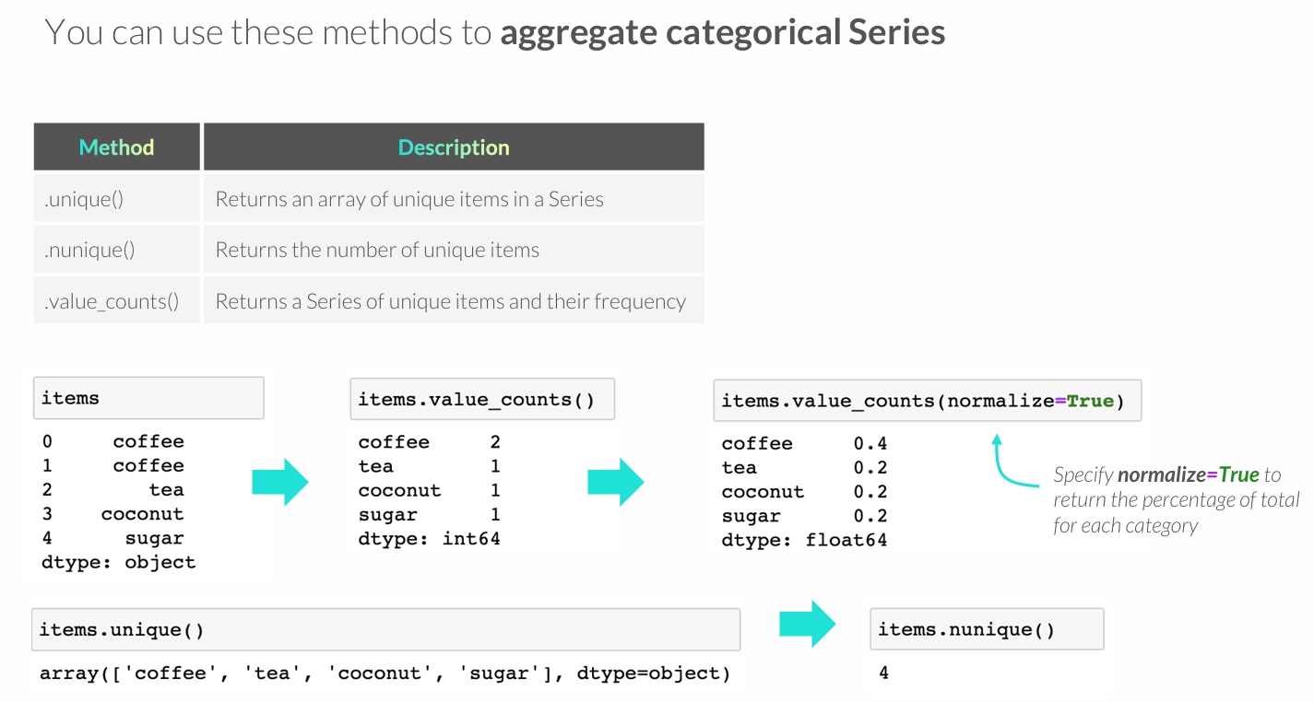
CATEGORICAL SERIES AGGREGATION
Notes:
SVARBU

Slide 25
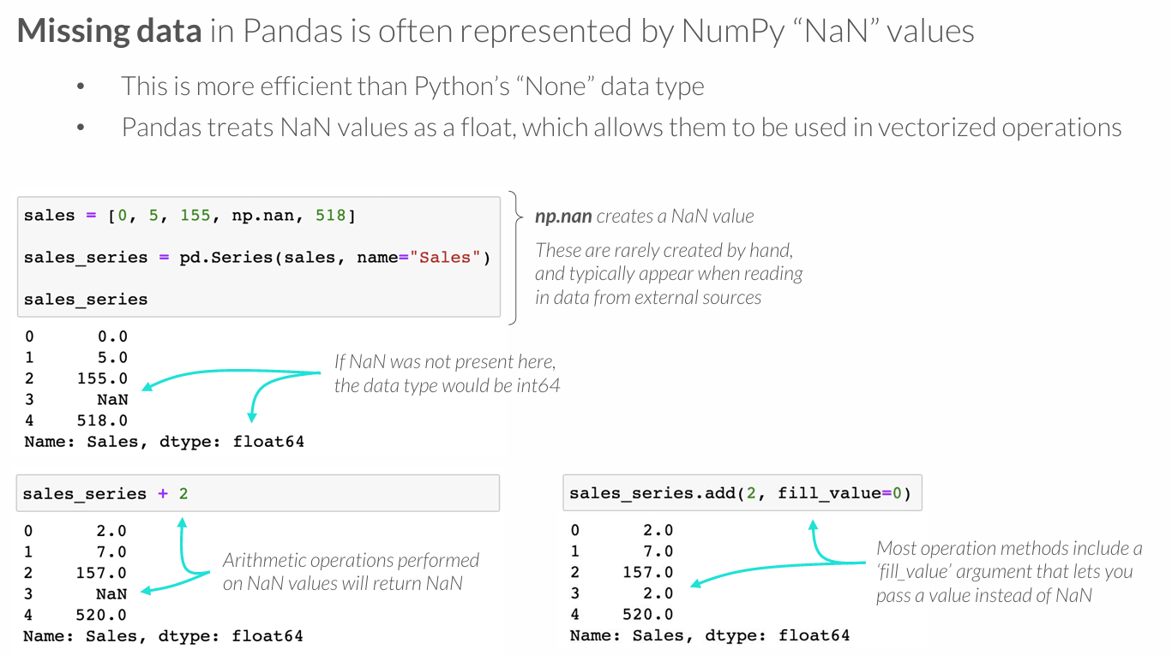
MISSING DATA

Slide 26
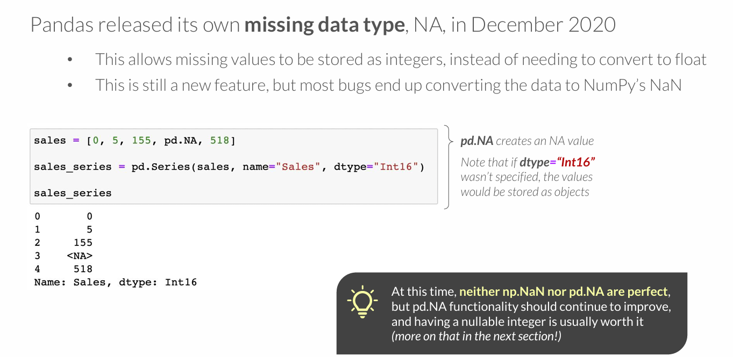
MISSING DATA

Slide 27
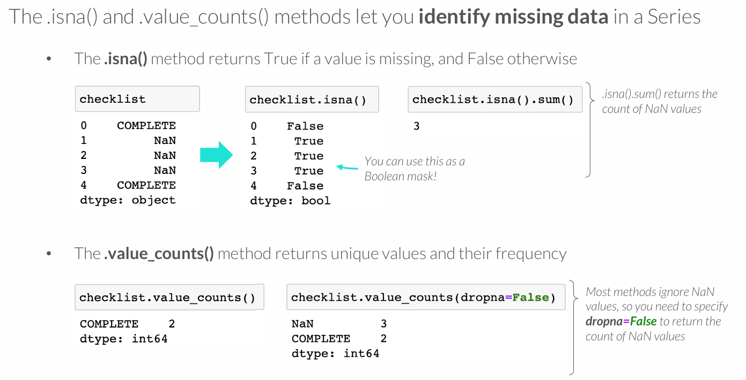
IDENTIFYING MISSING DATA

Slide 28
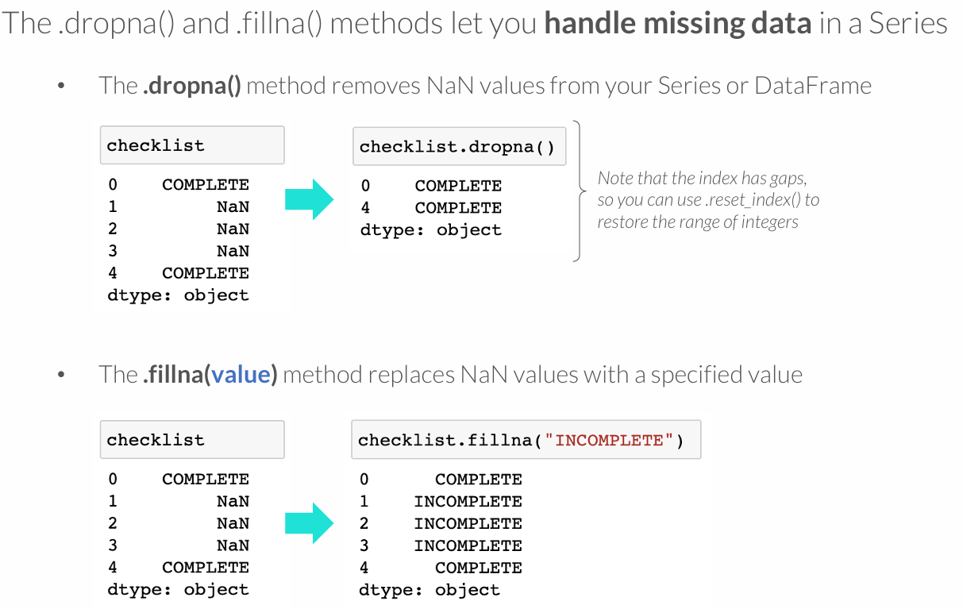
HANDLING MISSING DATA
Notes:
LABAI SVARBU

Slide 29
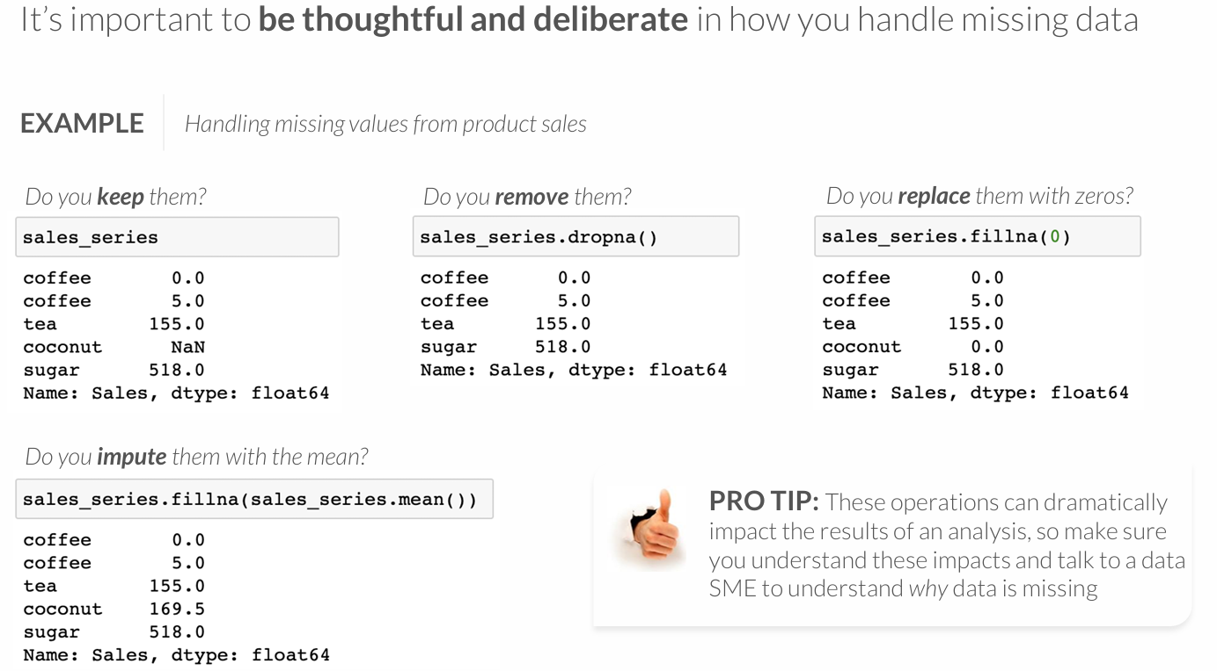
HANDLING MISSING DATA

Slide 30
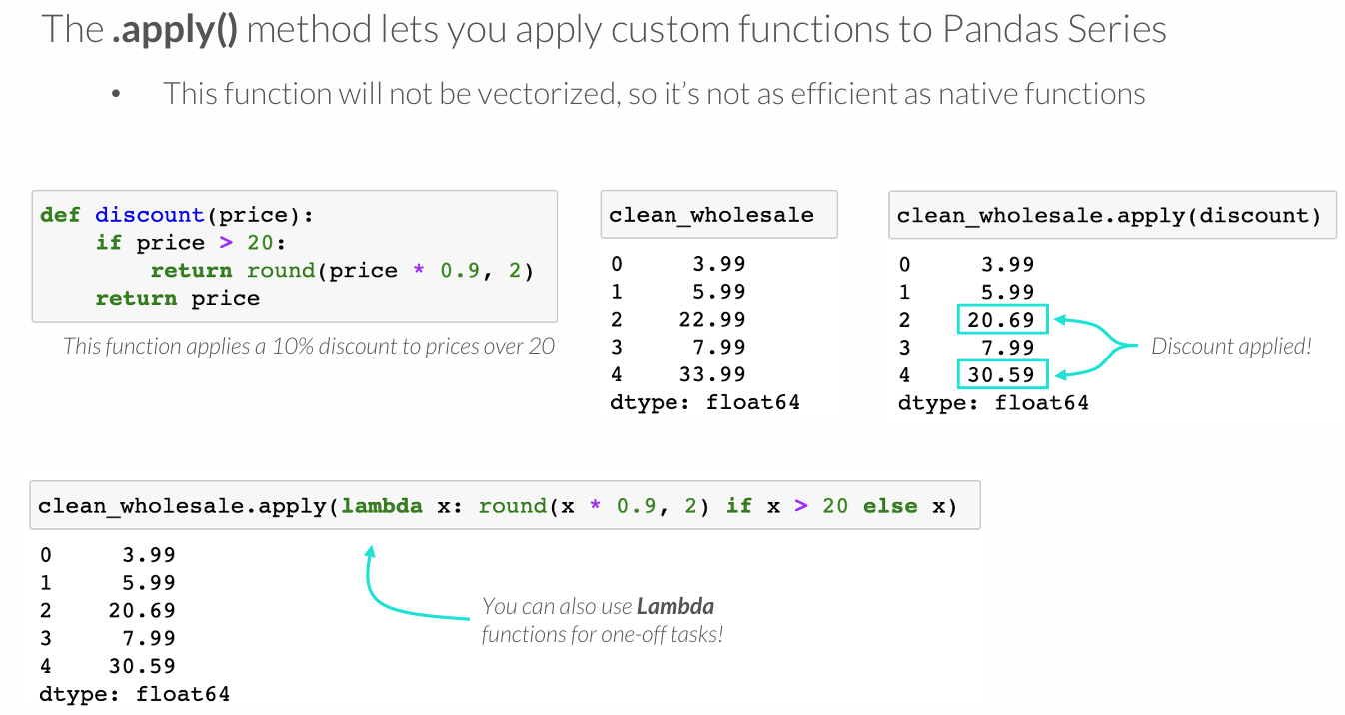
THE APPLY METHOD
Notes:
SVARBU

Slide 31
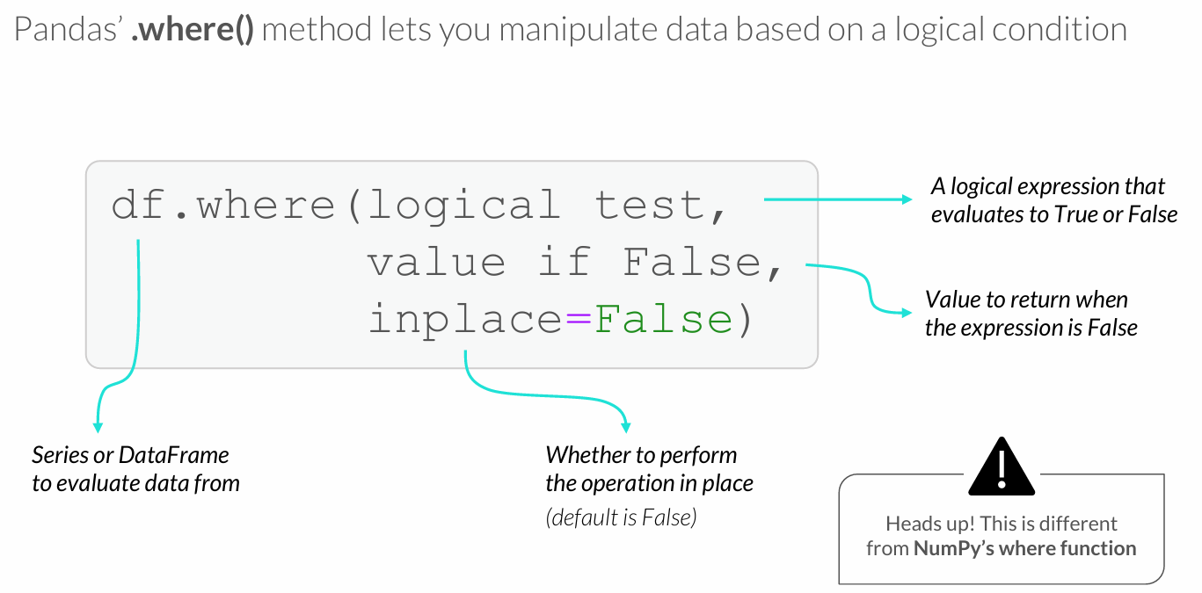
THE WHERE METHOD

Slide 32
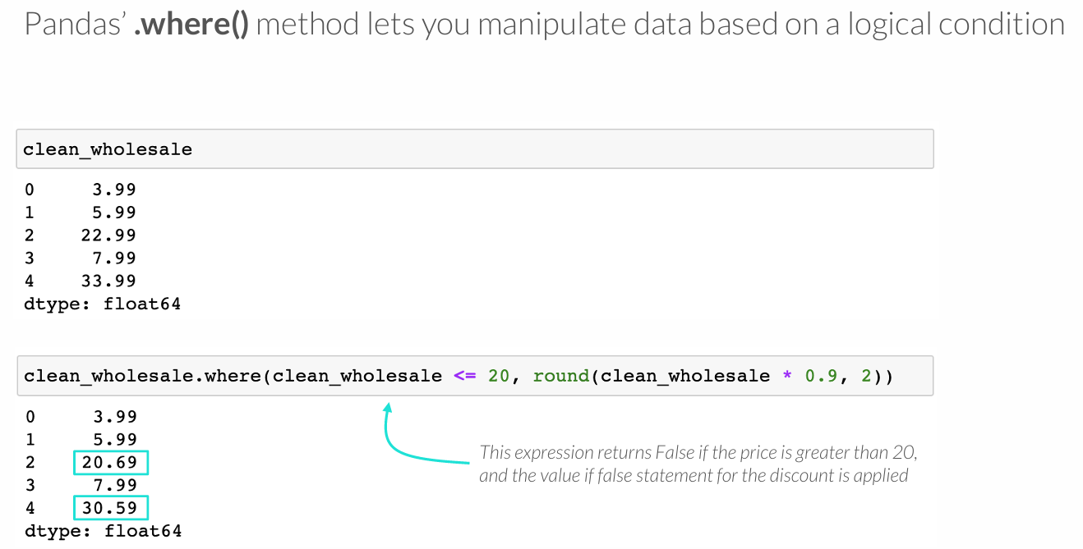
THE WHERE METHOD
Notes:
PRIKLAUSO

Slide 33
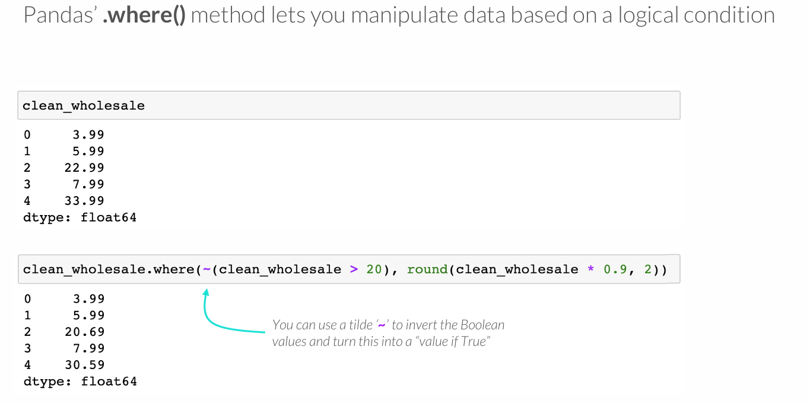
THE WHERE METHOD

Slide 34
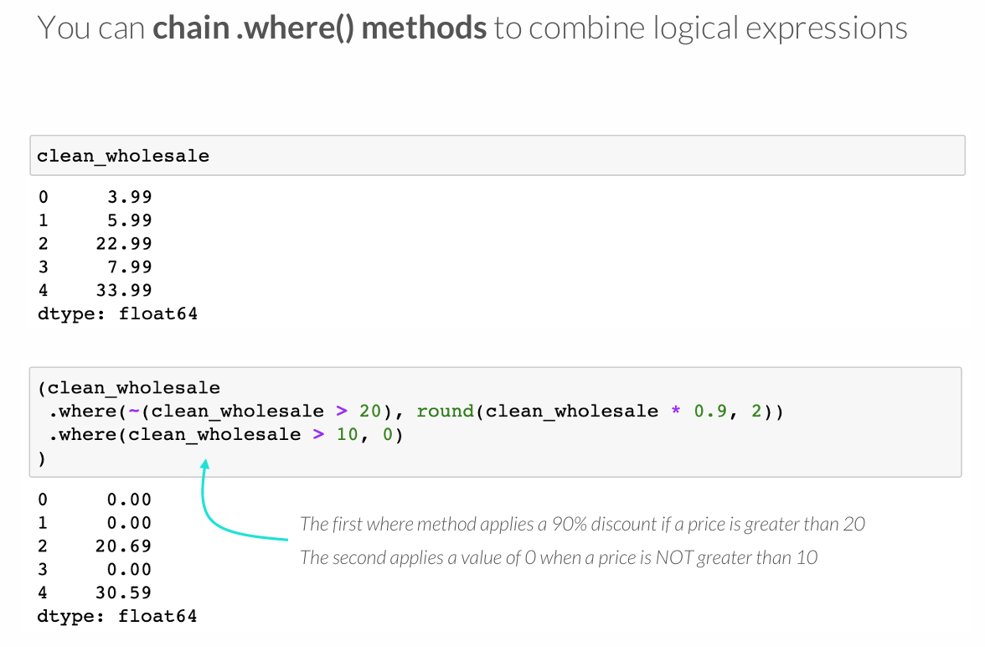
CHAINING WHERE

Slide 35
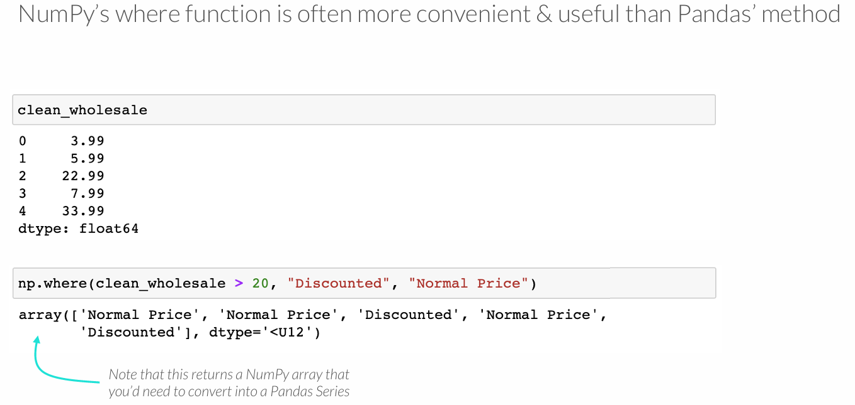
NUMPY VS. PANDAS WHERE
Notes:
LABAI SVARBU

Slide 36
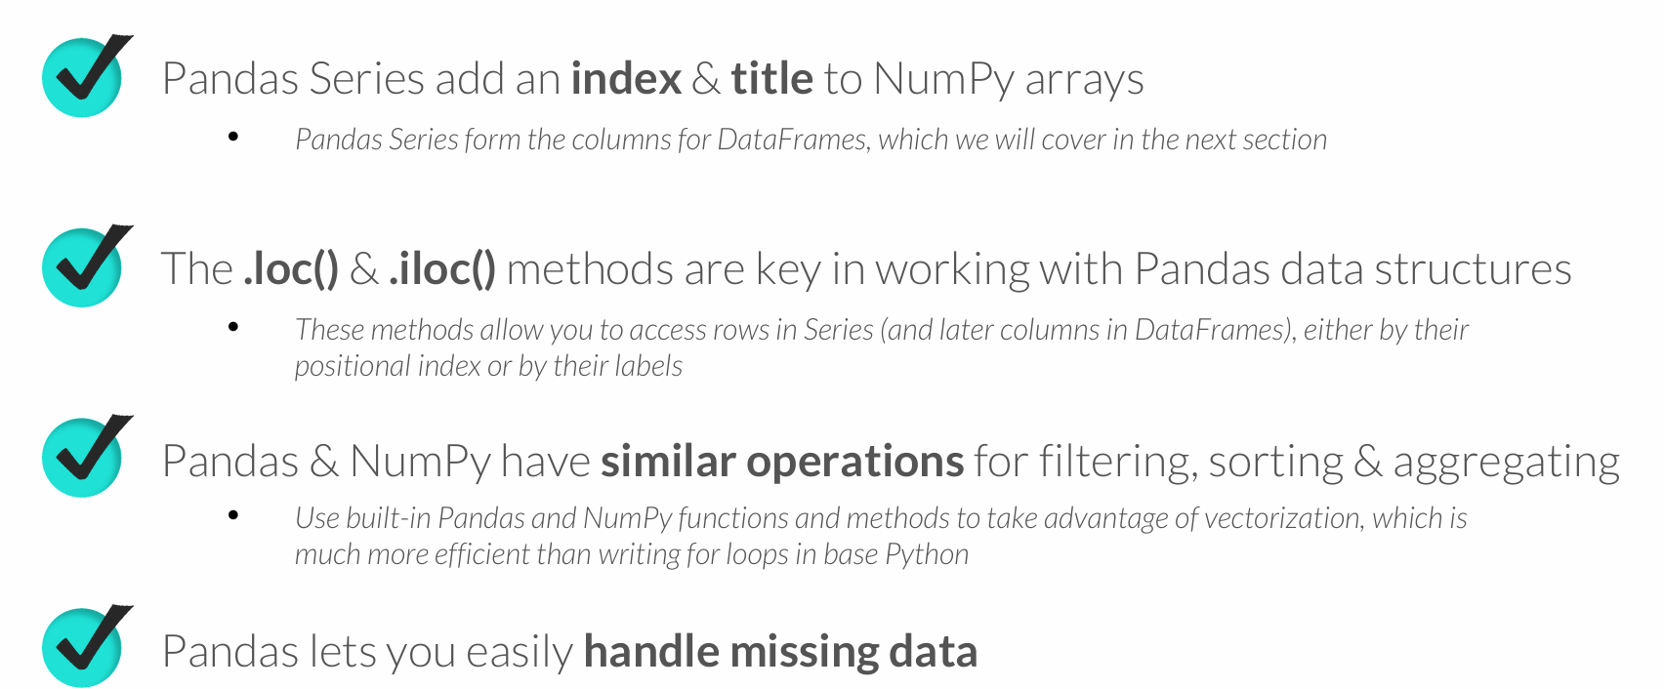
KEY TAKEAWAYS

